Slide 1
Welcome TO
S3 Static Website Hosting
Mini Project By:
Bharat Vikas Rakshitha N Dip Lahane
Tawheed Mahalthy Vijay Kumar

Slide 2
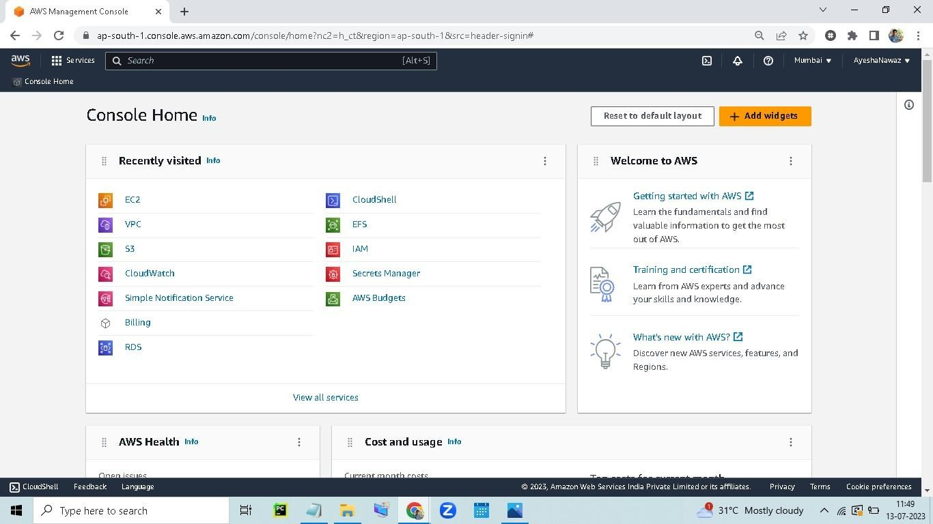
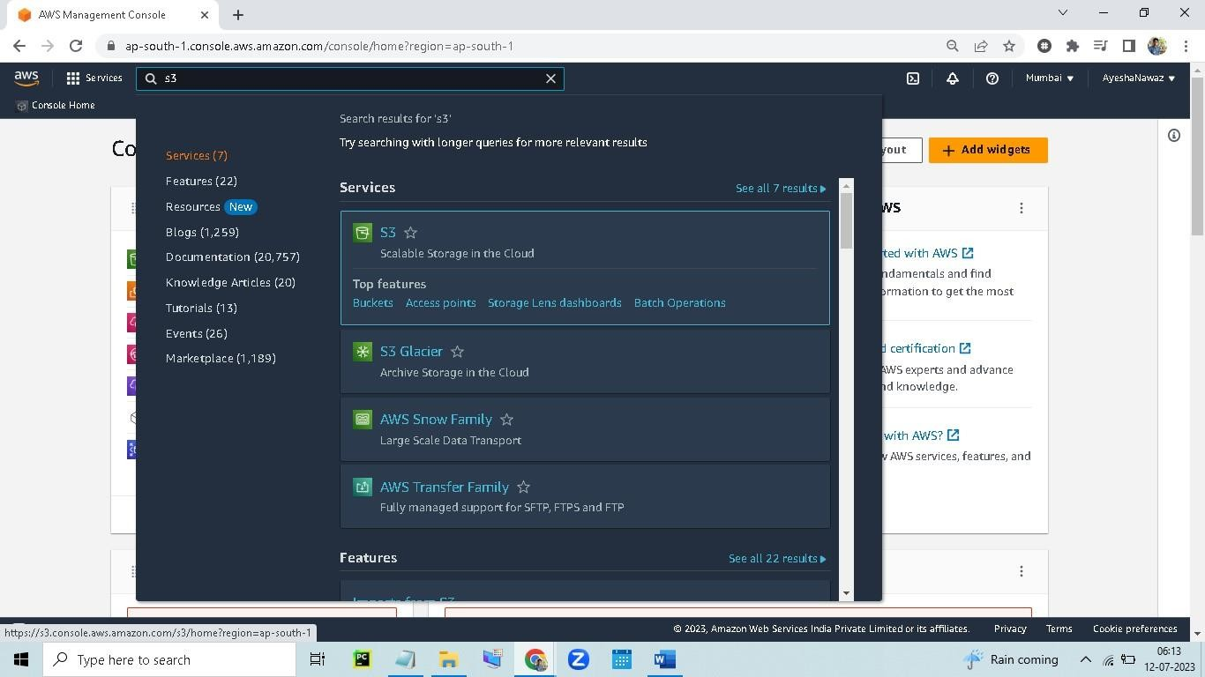
Task 1
1.1 Create an S3 Bucket, Upload & Access Files, And Host the Website:
1. Go to the AWS Management Console: https://console.aws.amazon.com/ and sign in to your account.
2. Click on the S3 service

Slide 3
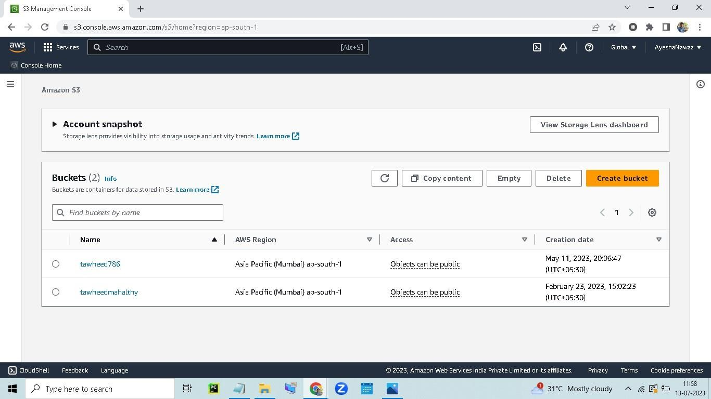
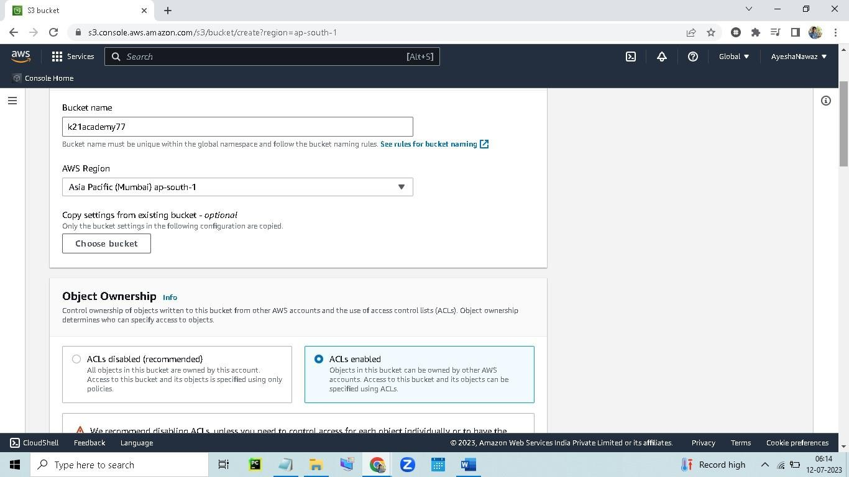
3. Click on the Create Bucket button
4. Enter a name for your bucket

Slide 4
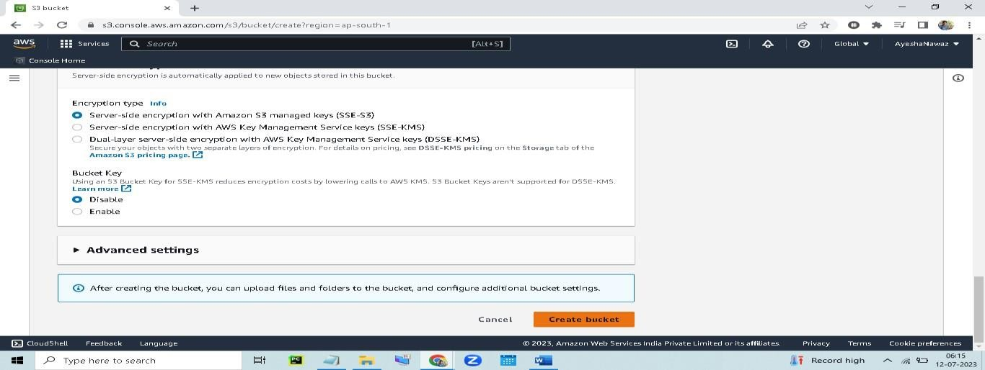
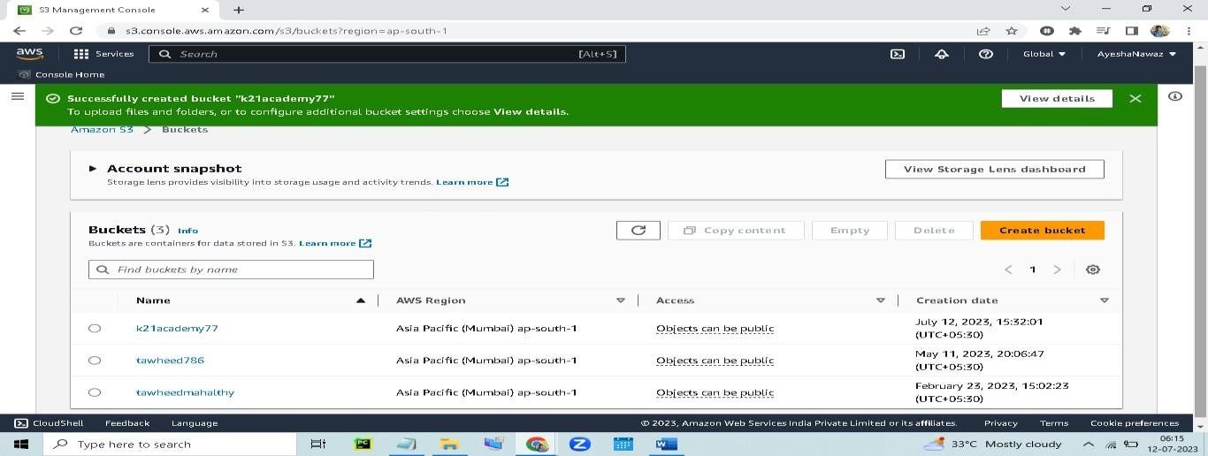
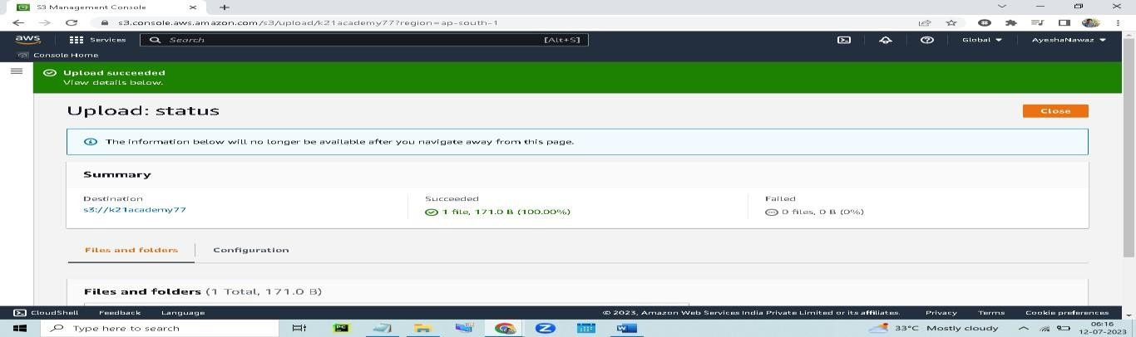
5. Click on the Create button
6. Once your bucket is created, click on the Upload button.
Upload your website HTML file here

Slide 5
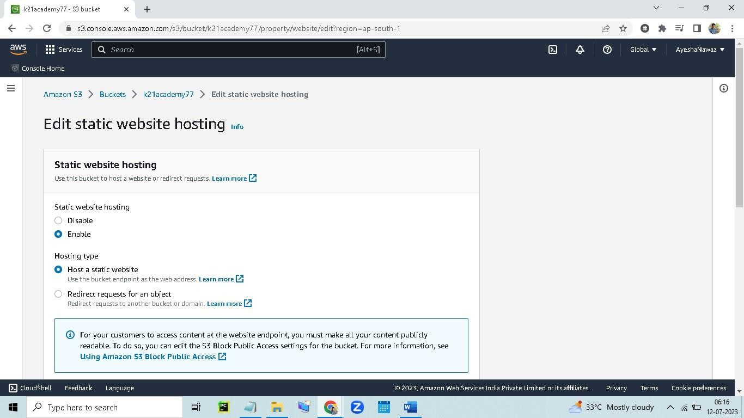
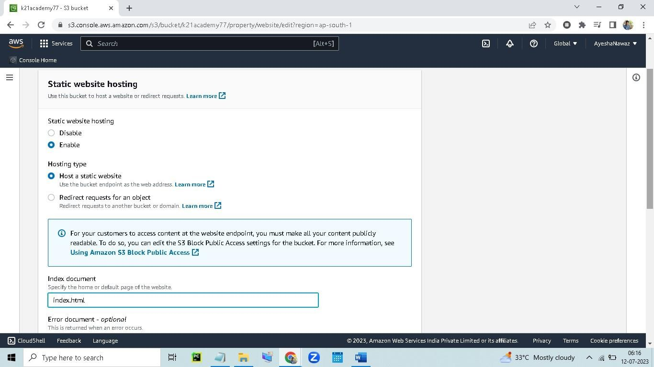
Once your files are uploaded, you can access them by clicking on the Objects tab
To host a website, you need to enable static website hosting for your bucket
Click on the Properties tab
Scroll down to the Static website hosting section.
Select the Enable static website hosting checkbox
12.Enter the index document name

Slide 6
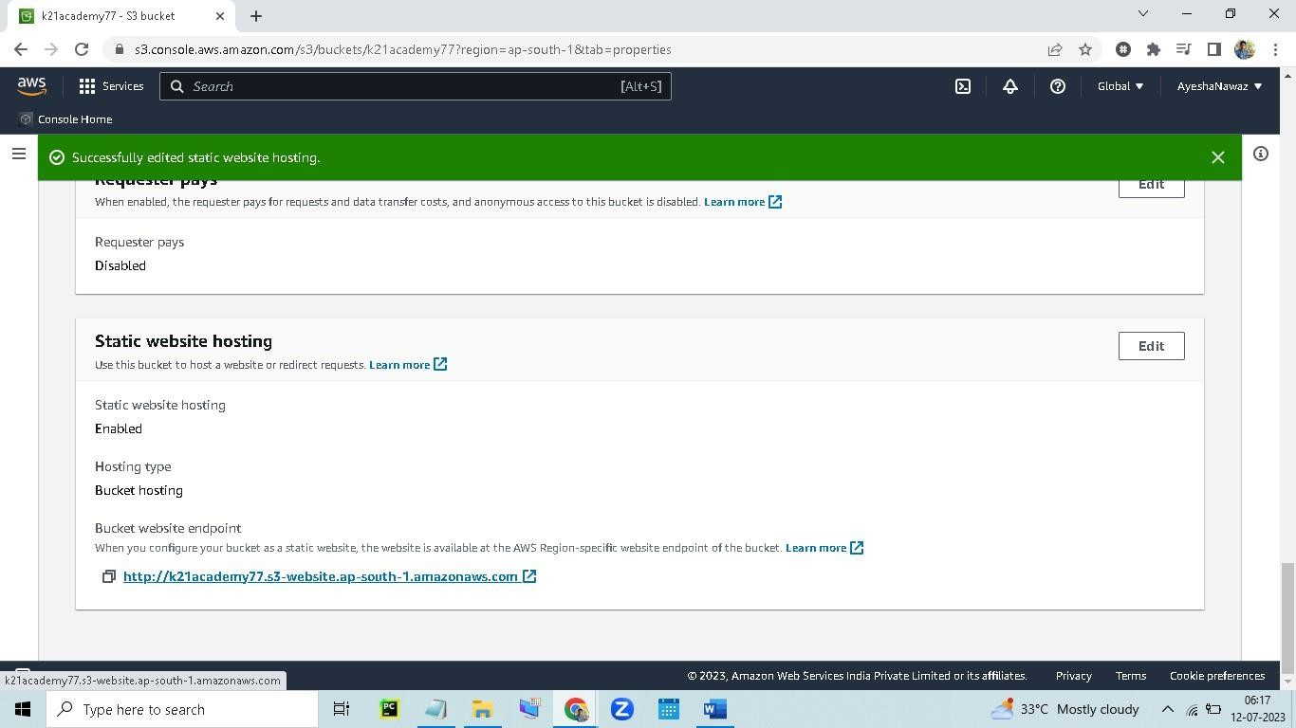
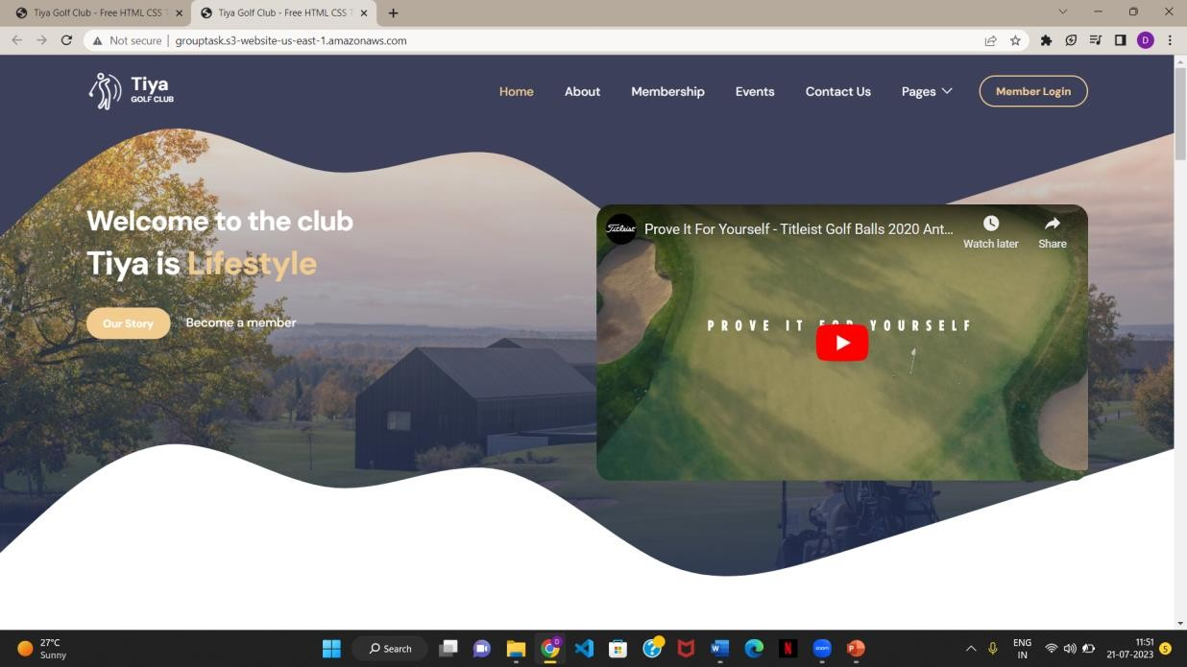
13.Click on the Save button
14.Once static website hosting is enabled, you can access your website by entering the bucket URL in your browser.
Output:

Slide 7
Thank You

